Slide 1

Global Life Expectancy
and Related Factors
December 1st, 2022
Pooja Kabber, Echo Chen, Dingkun Yang, Andrew Kroening

Slide 2
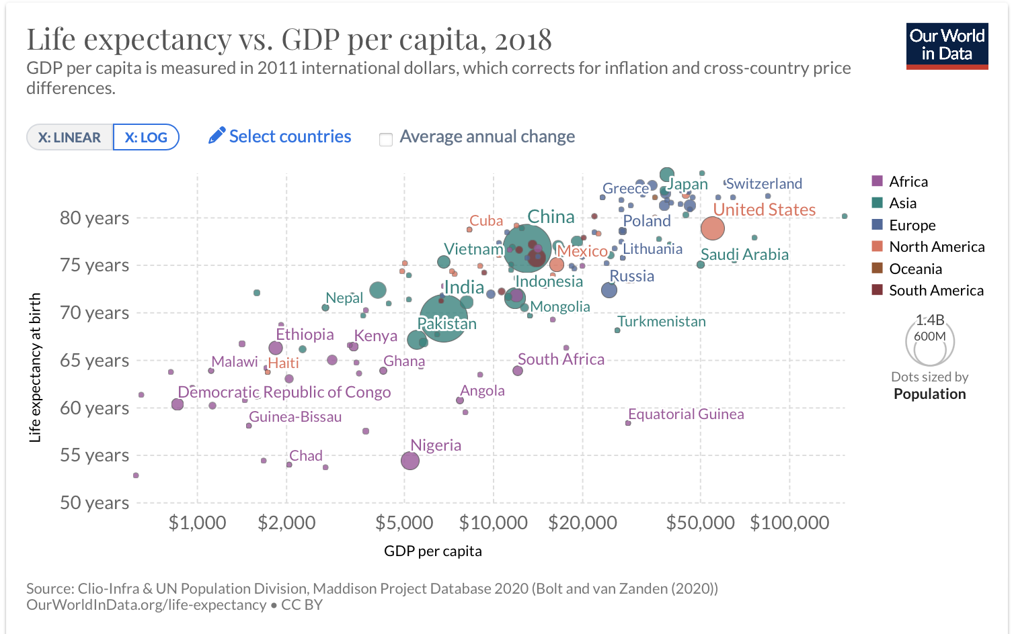
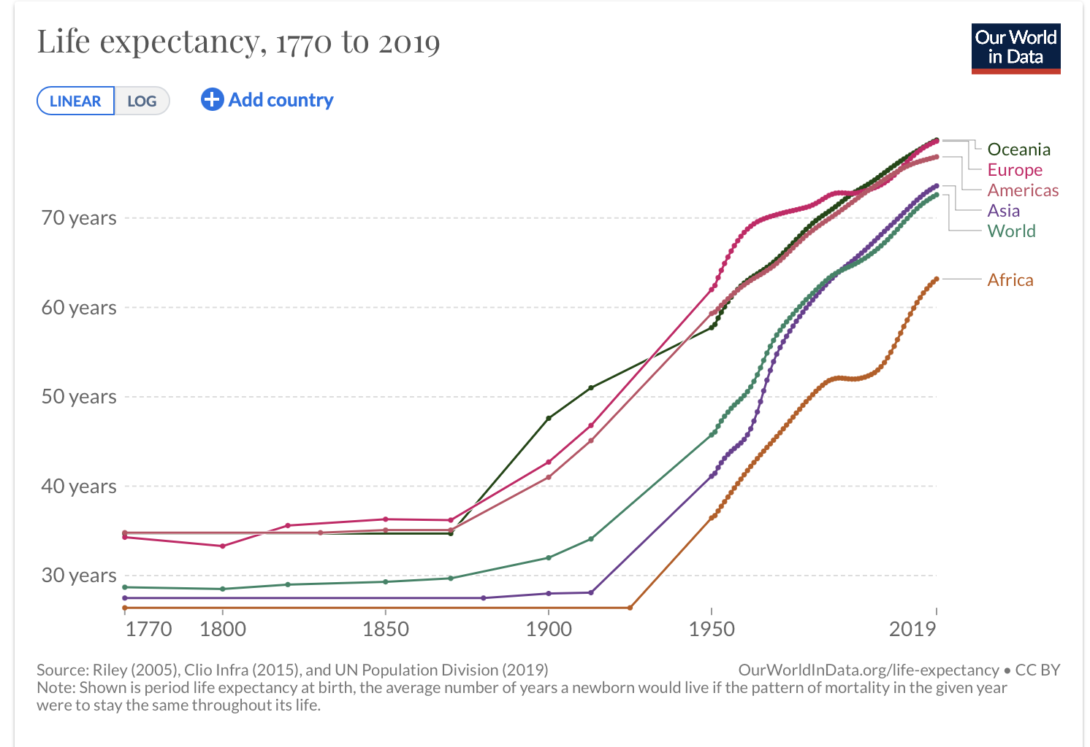
Introduction | Motivation
Global life expectancy is increasing as a trend. It is a possible indicator for the overall quality of life in a society.
Some countries/regions still lag in this metric, and there is some evidence that economics is involved.
Need more understanding to drive “high-payoff” policy recommendations.
We seek to determine if we can find areas for countries to invest in to improve quality of life.
Notes:
Andrew

Slide 3



Dataset | Overview
Data span years 2000 - 2015, with one observation per country for 21 variables.
We chose to omit some missing values where we could not find what we felt was “high-fidelity” replacement data.
Reduce to two subsets: one each for the years 2013 (out-of-sample) and 2014 (primary).
Most variables are related to either economics, health or societal well-being.
Research data sources: Life Expectancy (WHO) | Kaggle & World Bank
Notes:
Pooja
Data sources - WHO, Kaggle, World Bank
Missing data - searched for sources (data didn’t match, probably differences in data collection and calculation)
Factors - economical, societal, health

Slide 4
Dataset | Variables
Descriptive
Country Name Year
Health
Life Expectancy Adult Mortality Rate
Alcohol Use Hepatitis B Immunizations
Measles Incidence Body Mass Index (Average)
Deaths under 5 years of age Polio Immunizations
Diphtheria Immunizations HIV/AIDS Fatalities
Thinness among 1-19 yr-olds Infant Deaths
Thinness among 5-9 yr-olds
Social
Average Years of Schooling Population (Est.)
Development Status
Economic
Income Composition of Resources
Gross Domestic Product (GDP)
Government Expenditure on Health (% GDP)
Government Expenditure on Health (% Total)
Data span years 2000 - 2015, with one observation per country for 21 variables.
We chose to omit some missing values where we could not find what we felt was “high-fidelity” replacement data.
Reduce to two subsets: one each for the years 2013 (out-of-sample) and 2014 (primary).
Most variables are related to either economics or societal well-being.
Notes:
Andrew

Slide 5
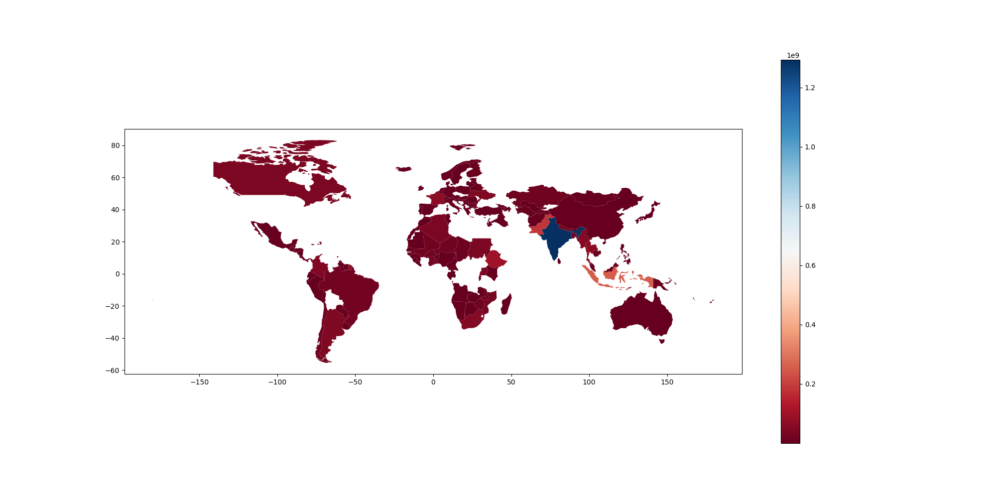
Dataset | Missingness
Original dataset
had a significant
number of missing
population values.
Also had concerns
about the scale and
measurement of some
population counts in
the original Kaggle dataset.
To compensate, we added population data from the World Bank, which we believe is high-quality
Original Dataset Population Values on Red-Blue Scale
Notes:
Andrew

Slide 6
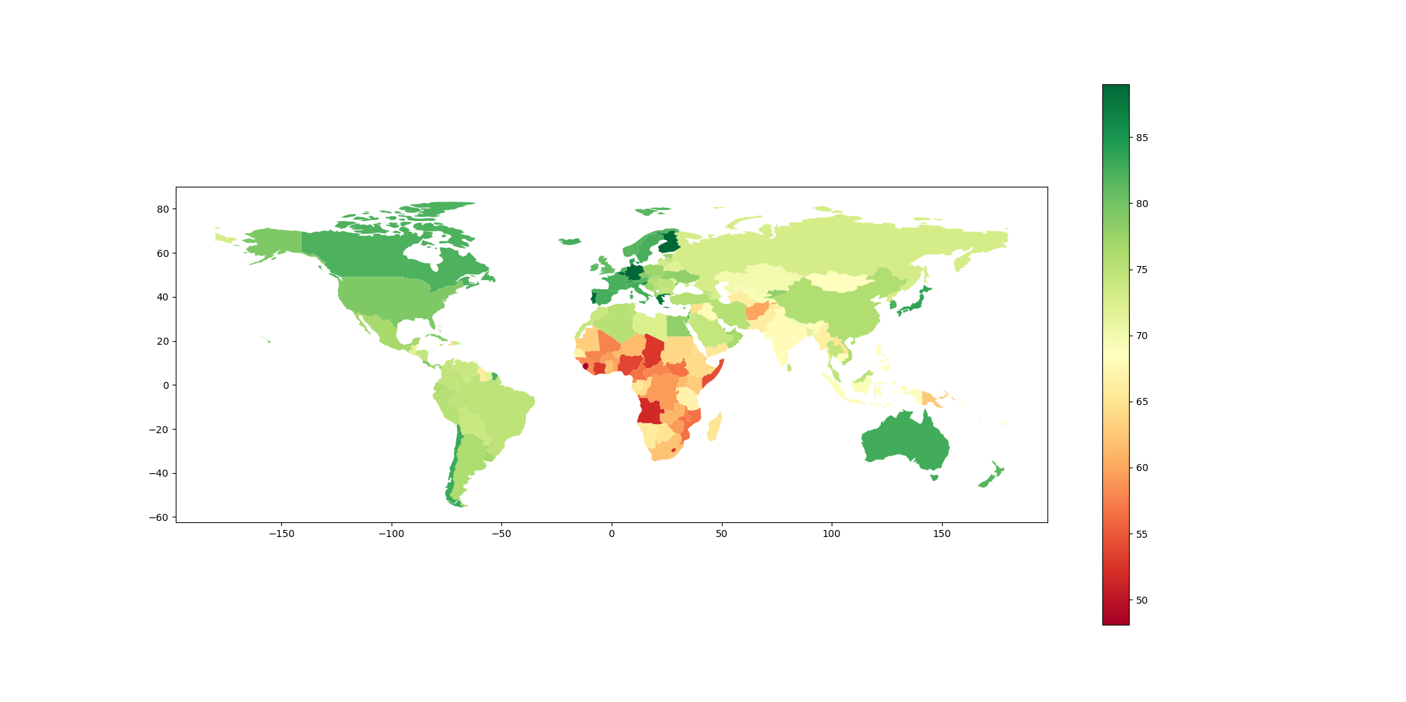
Question #1 | Introduction
"How did major disease, economic, and social factors impact life expectancy around the globe in 2014?"
Global Life Expectancies by Country
Notes:
Life expectancy is lowest in west and south asia and africa, highest in europe
Pooja

Slide 7
Question #1 | Feature Selection (A Priori)
Social | Health | Economic
Status | Measles (no. of reported cases per 1000 people) | Total Expenditure (% of govt expenditure on health)
Population | Polio (polio immunization coverage % among 1 year olds)
Schooling (no. of years of schooling) | HIV (deaths per 1000 for 0-4 year olds)
 | BMI (average BMI of whole population)
 | Adult Mortality (probability of dying between 15 and 60 per 1000 people)
Notes:
Our a priori variables - interests, representation for each of social, health and economic factors and correlation
Pooja

Slide 8
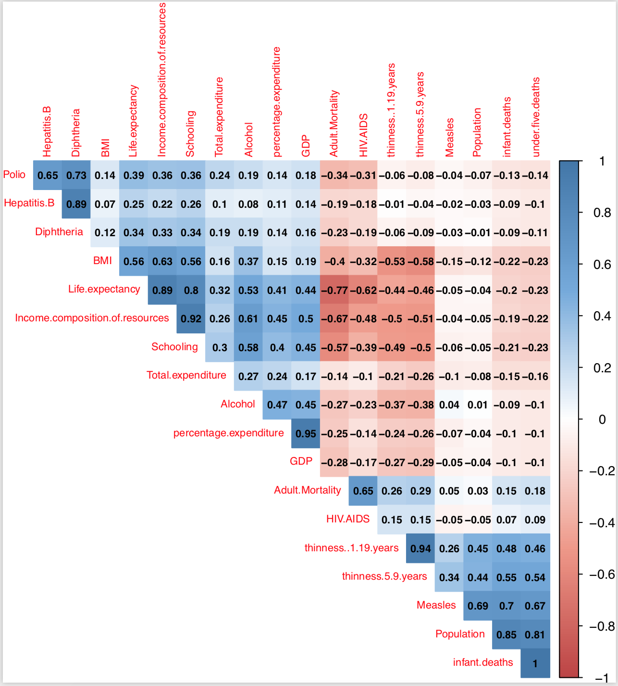
Question #1 | Correlations
Infant deaths (per 1000 people) | Under five deaths (per 1000 people)
Percentage expenditure (expenditure on health as a % of GDP) | GDP
Hepatitis B (% immunization coverage among 1 yr olds) | Diphtheria (DTP-3% immunization coverage among 1 yr olds)
Thinness (% from ages 10 to 19) | Thinness (% from ages 5 to 9)
Schooling (years of schooling) | Income composition of resources (HDI)
Notes:
Pooja

Slide 9
Question #1 | Methods
Model: Linear regression with continuous dependent variable Life Expectancy
Feature selection: Combination of a priori variables (variables of interest) and backward stepwise selection
Consideration: Used Status instead of HDI (Income composition of resources)
Model evaluation and selection: Adjusted R² and BIC
Model | Number of Variables | BIC | Adj.R² | Assumptions | Number of Significant Variables
Priori Model | 9 | 775.50 | 0.7683 | All met | 3
Full Model | 20 | 746.36 | 0.8615 | All met | 4
Backward | 6 | 691.28 | 0.8683 | All met | 4
Final Model | 10 | 747.08 | 0.8194 | All met | 5
Notes:
Pooja

Slide 10
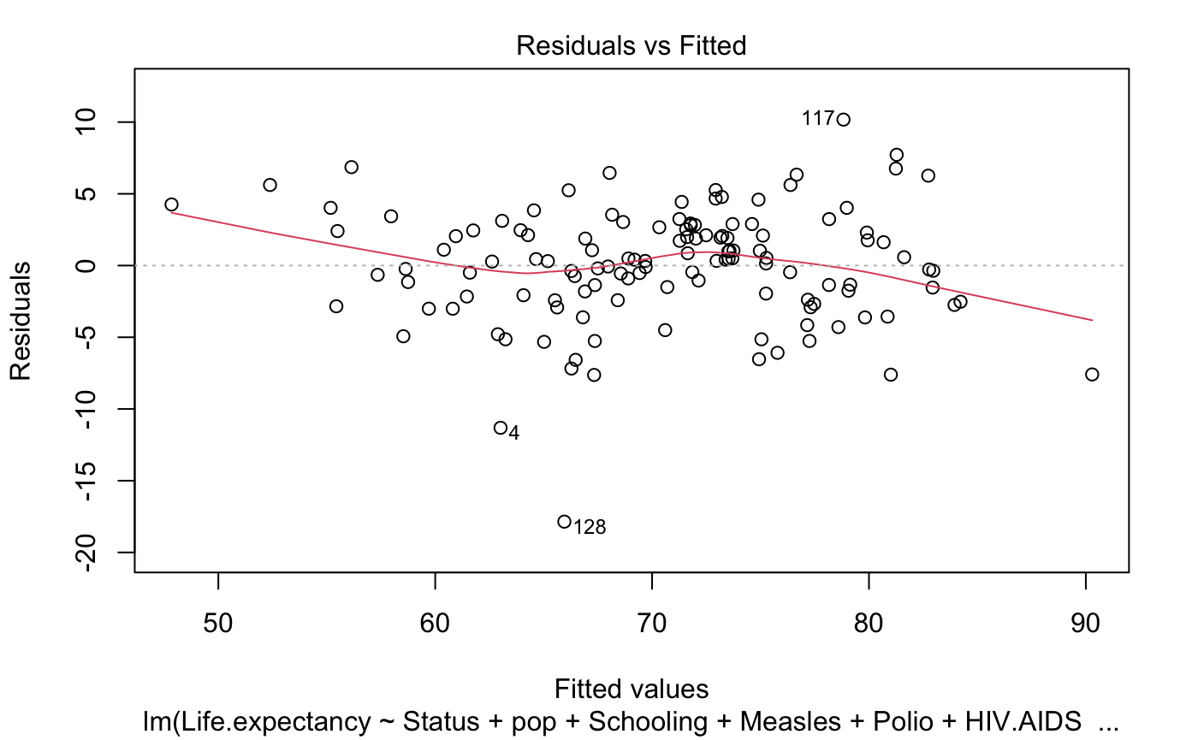
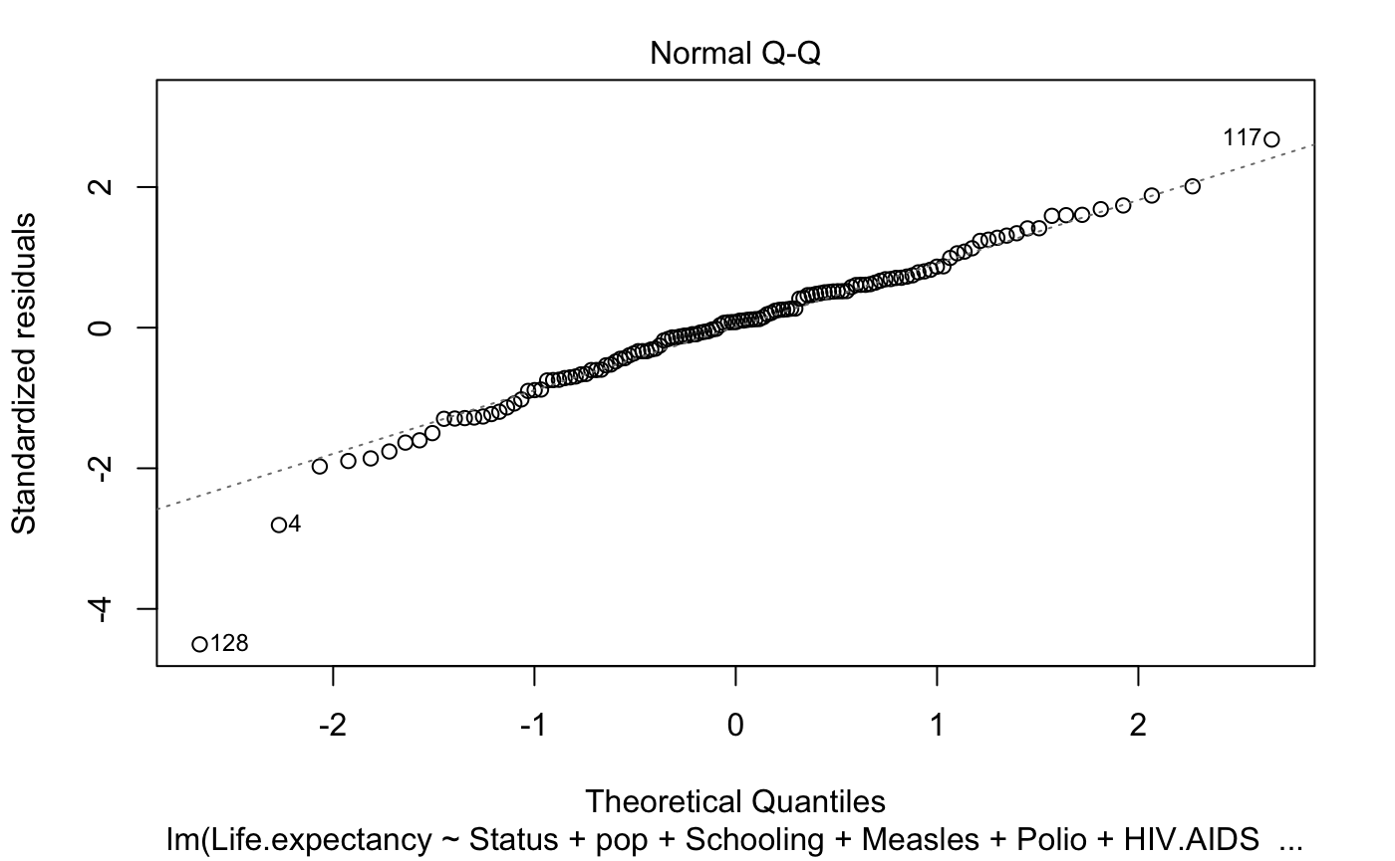
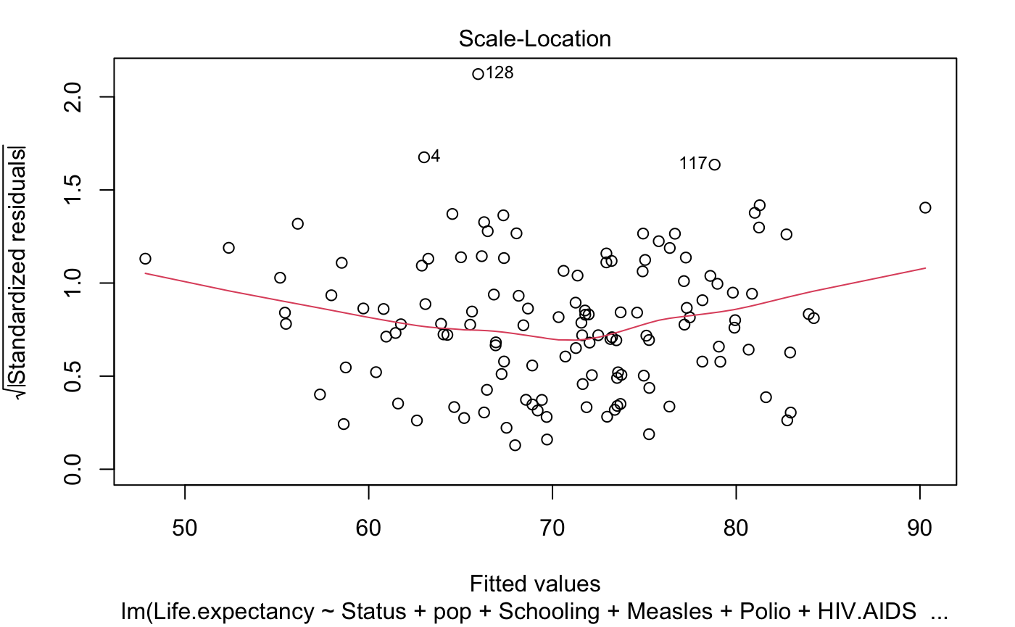
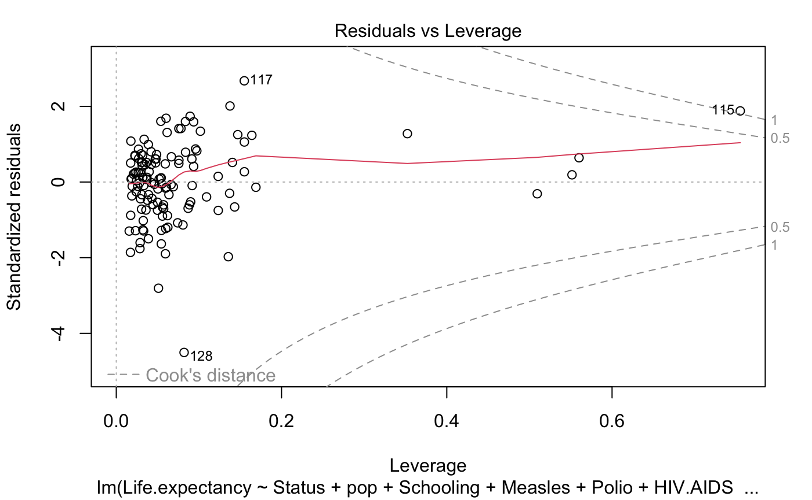
Question #1 | Model Validity
Notes:
Pooja

Slide 11
Question #1 | Model Result
Life Expectancy depends on
Adult Mortality
probability of dying between 15 and 60 per 1000 people
Total Expenditure
% of govt expenditure on health
HIV.AIDS
deaths per 1000 for 0-4 year olds
BMI
average BMI of whole population
Schooling
number of years of schooling
Notes:
Echo

Slide 12
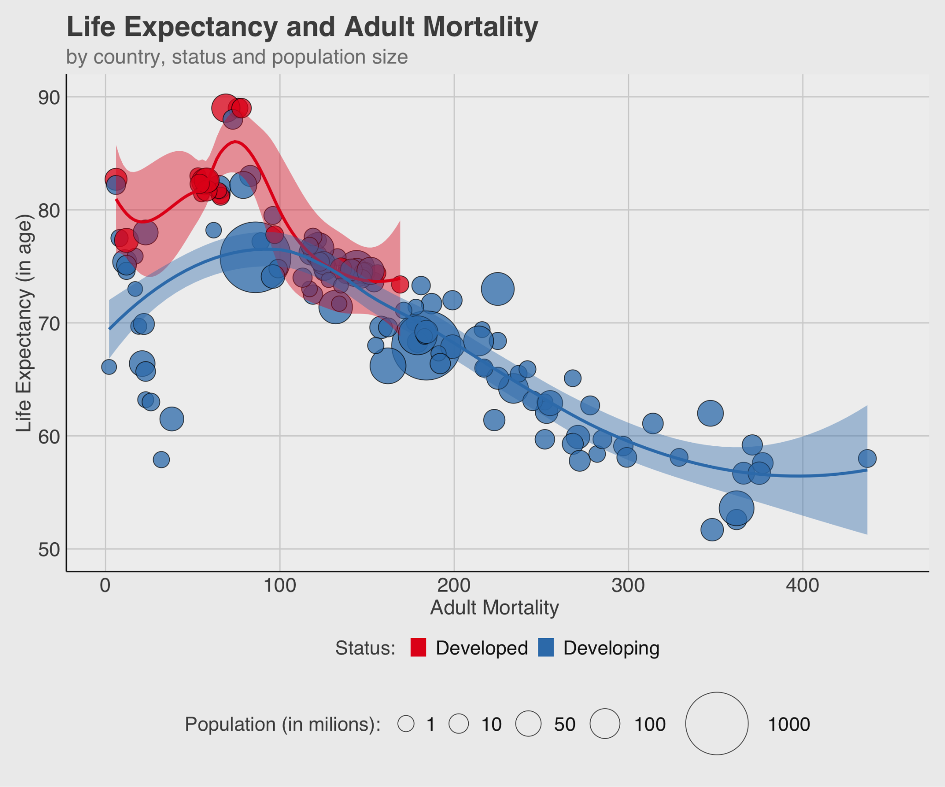
Question #1 | Results
Adults death
probability increase
0.1%
Life expectancy
0.03 year (11 days)
Notes:
Echo

Slide 13
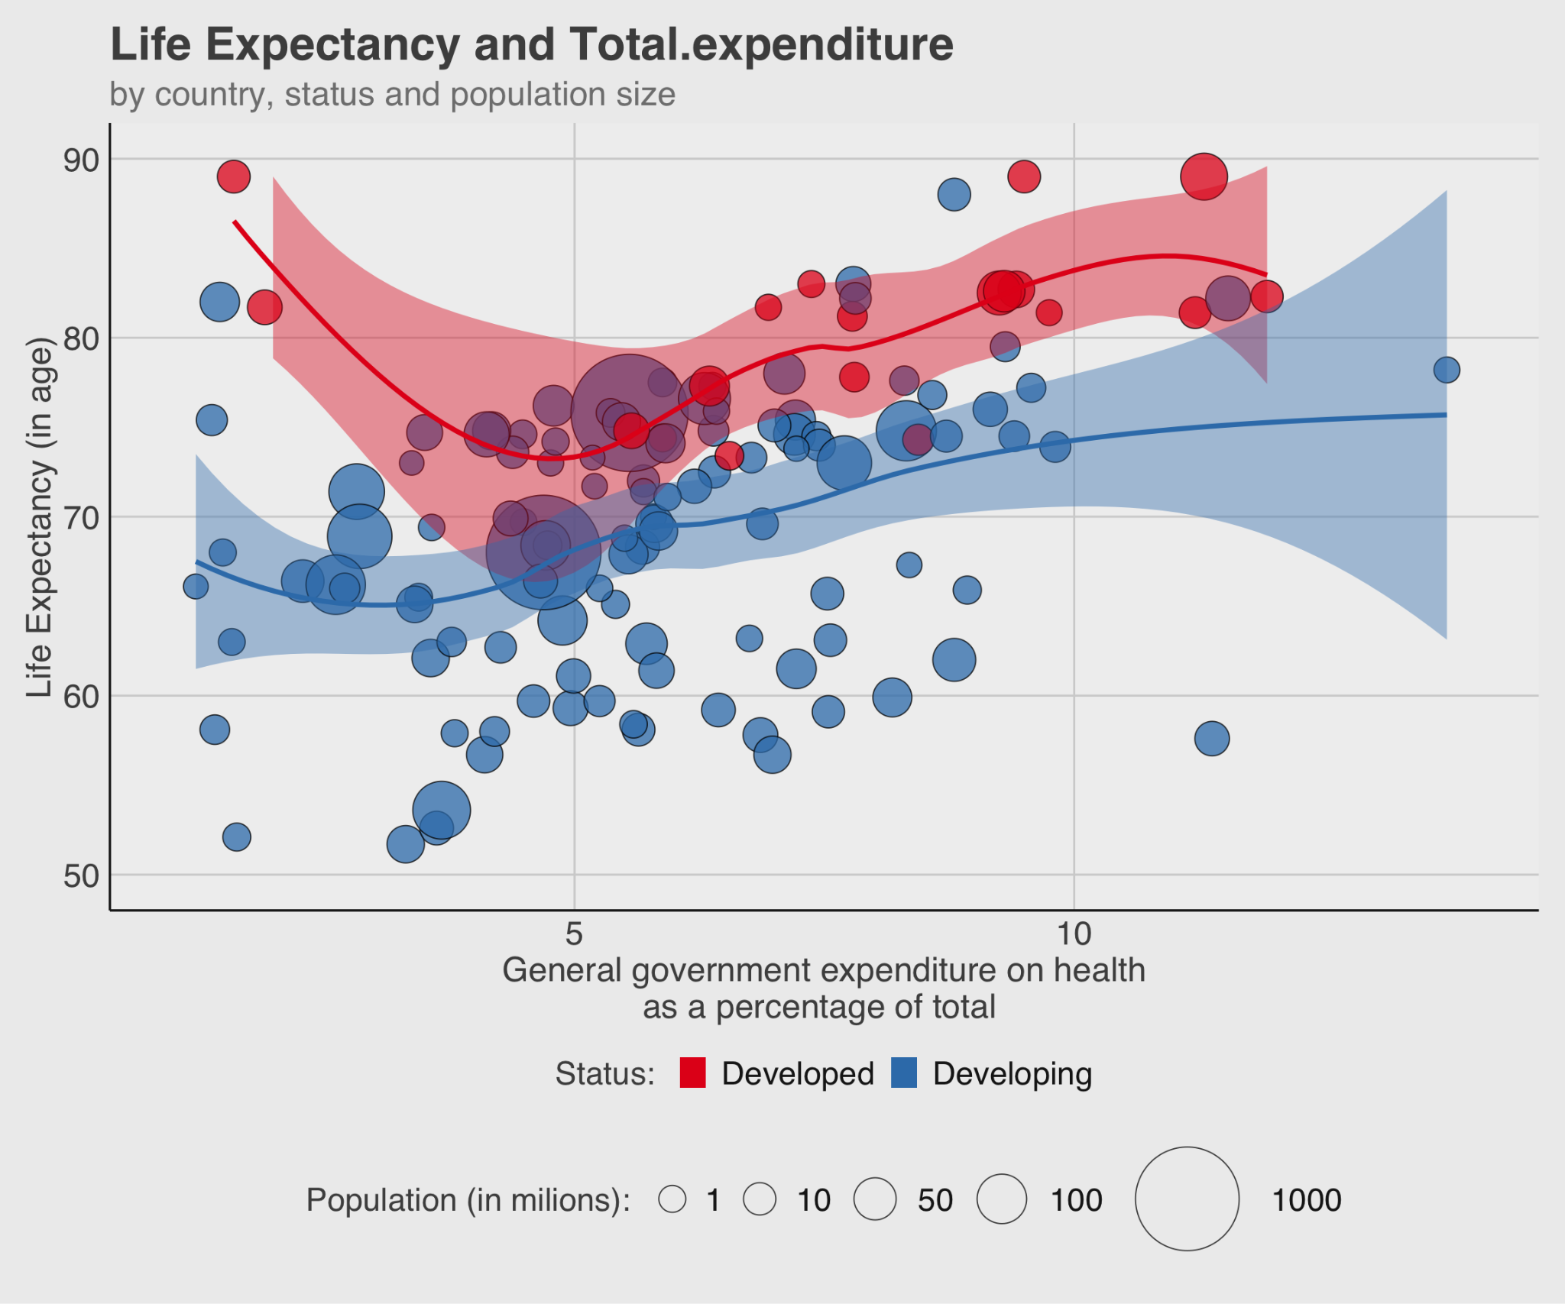
Question #1 | Results
General government expenditure on health
Rise 1%
Life expectancy
0.03 year (11 days)
Notes:
Echo

Slide 14
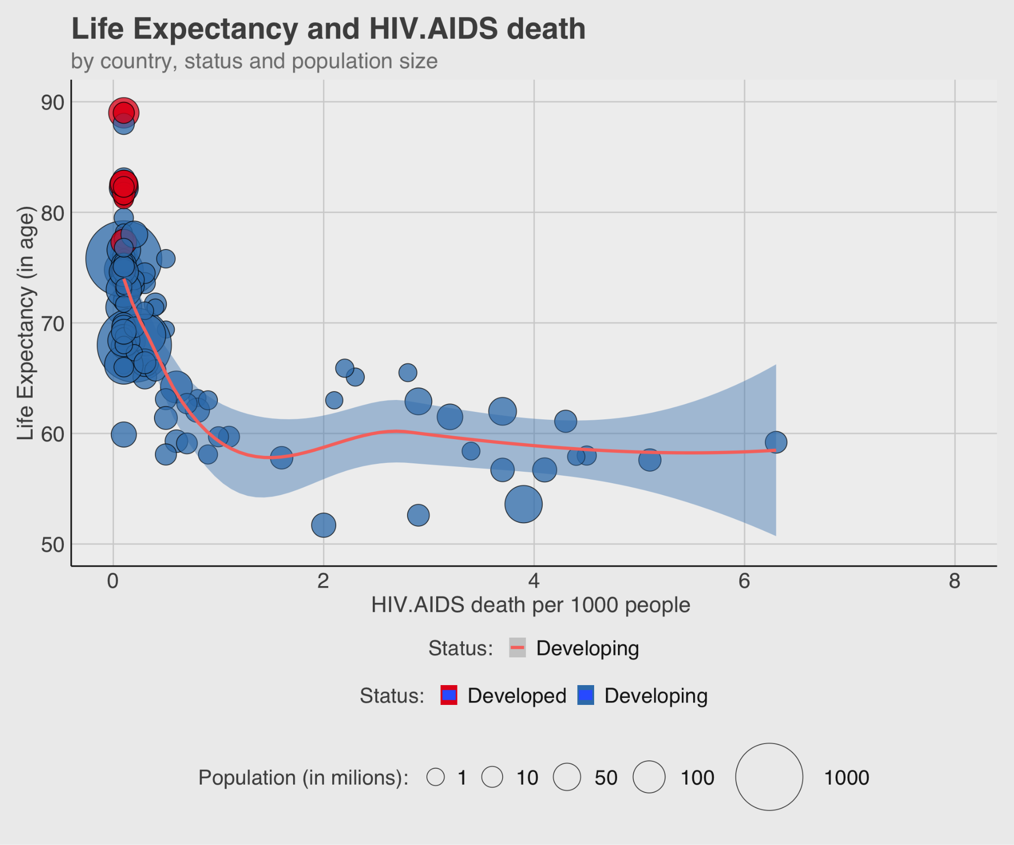
Question #1 | Results
(0-4 yrs) HIV
death rates
Rise 0.1%
Life expectancy
1.04 year (380 days)
Notes:
Echo

Slide 15
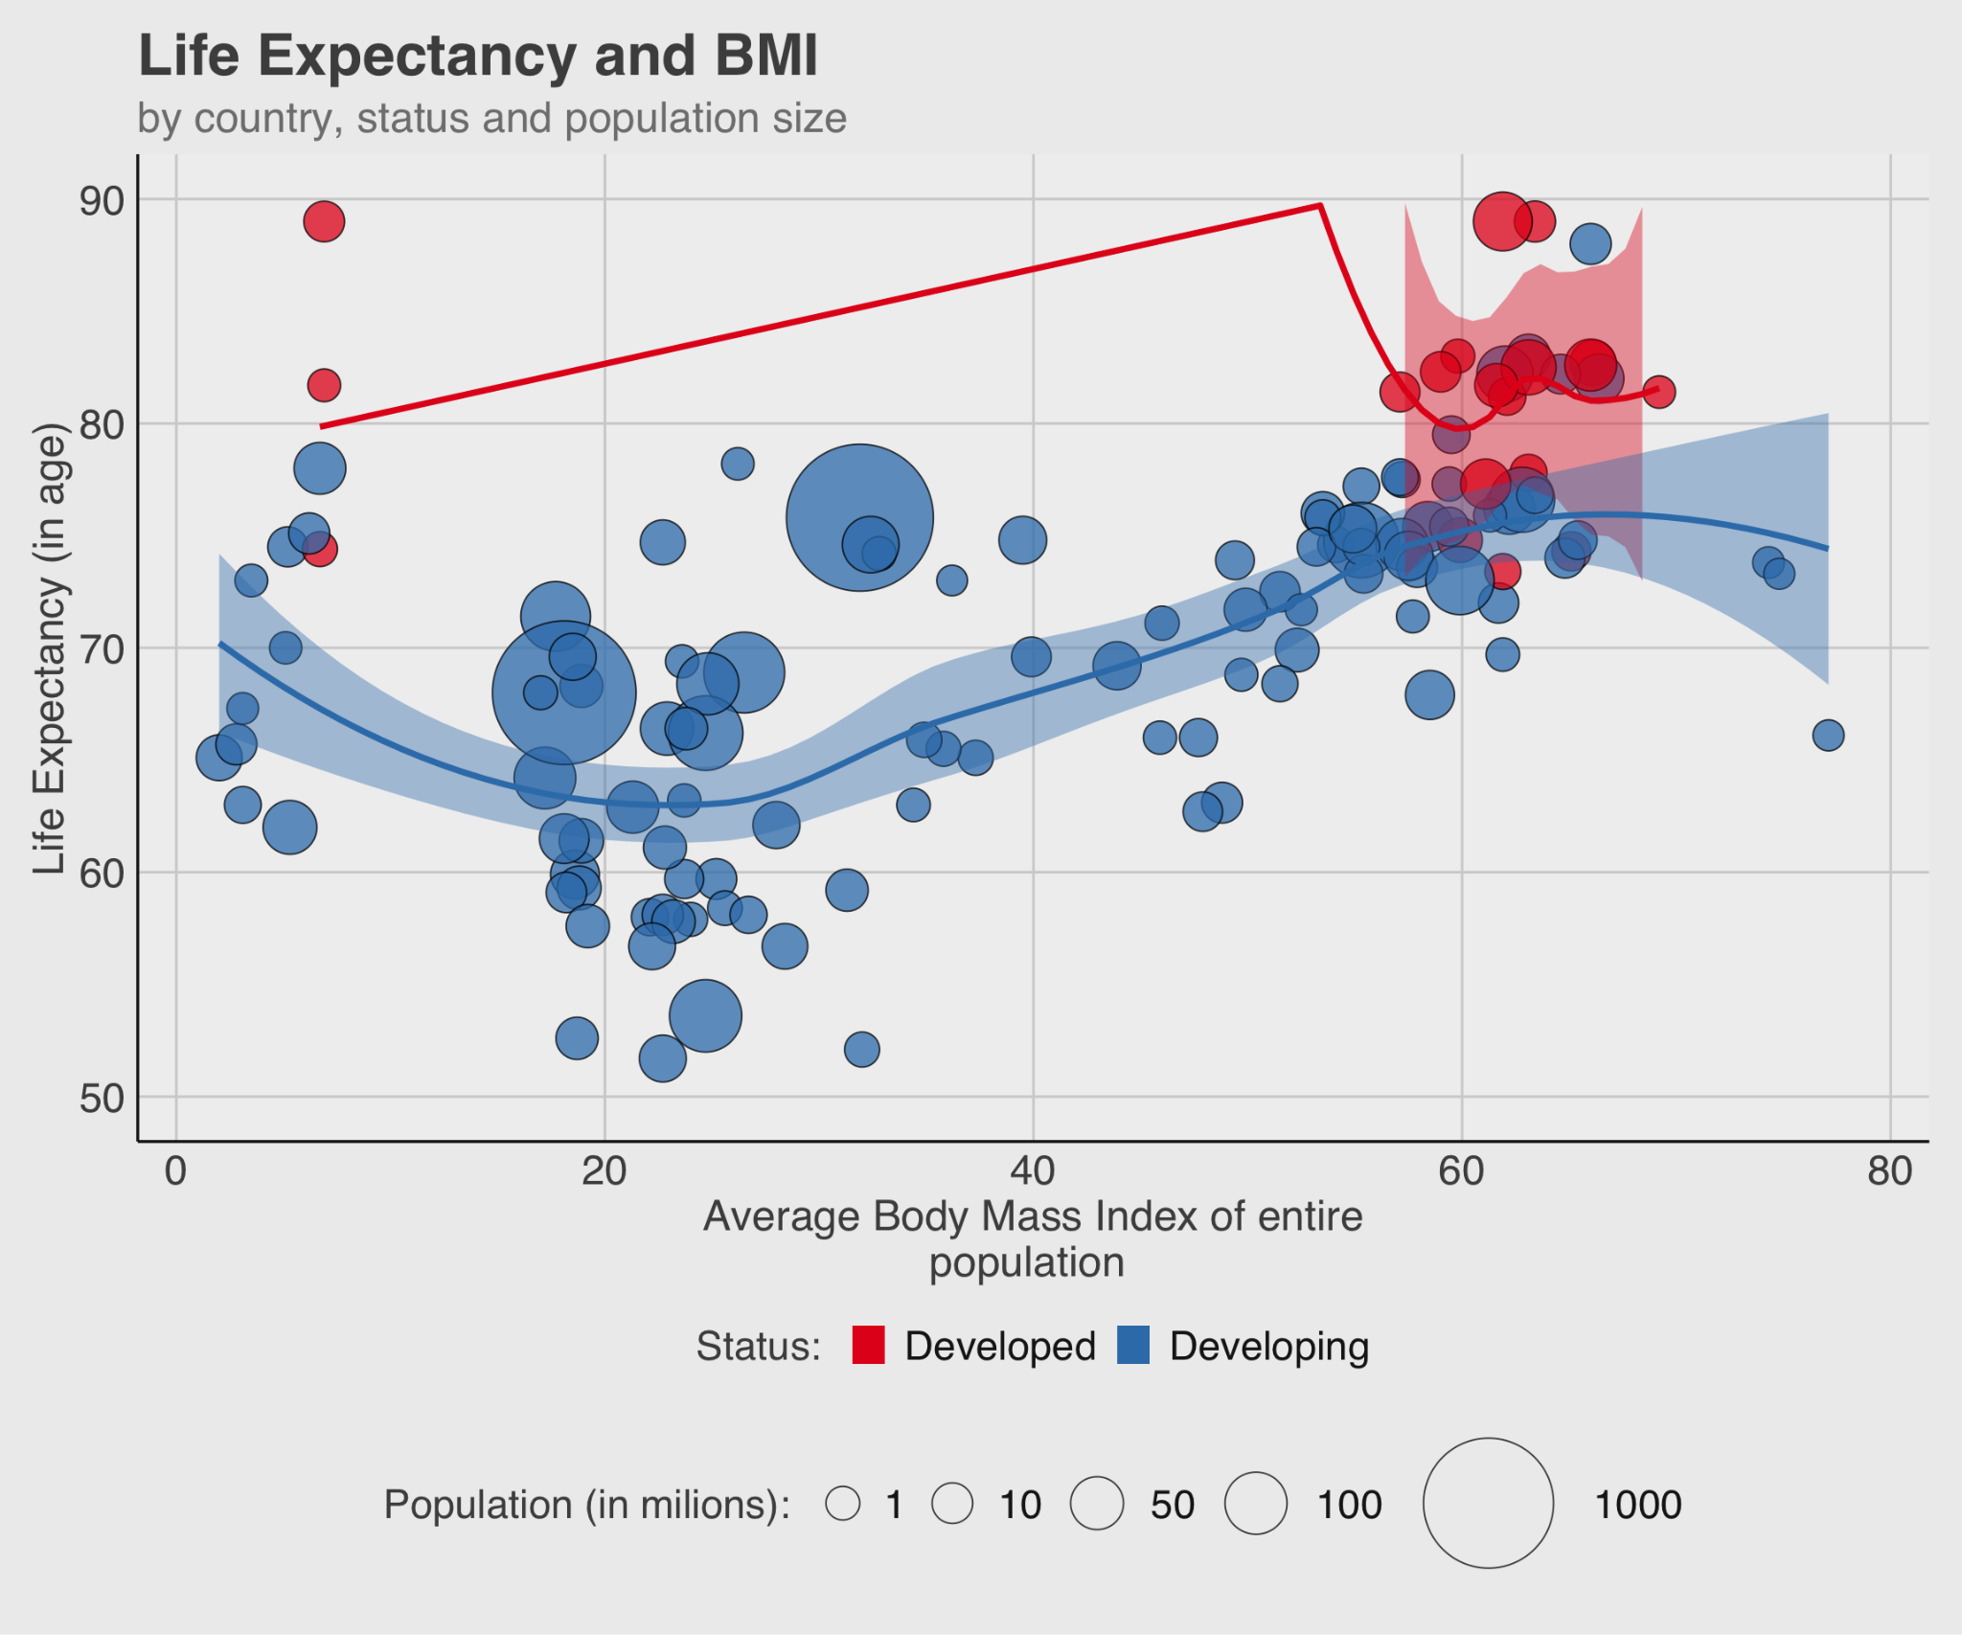
Question #1 | Results
BMI
Increase one unit
Life expectancy
0.04 year ( 17 days)
Notes:
Echo

Slide 16

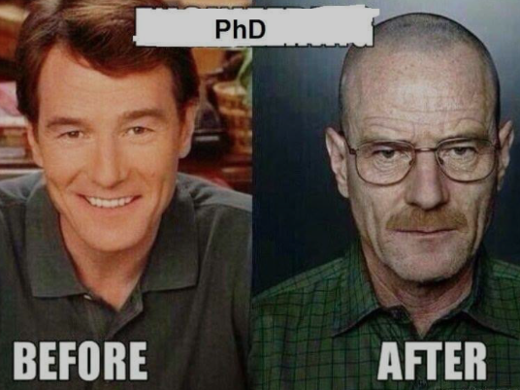

Question #1 | Results
Years of schooling rise by 1 year
Life expectancy
0.18 year (64 days)
Life expectancy
Year of schooling
Source ：Humandevelopmentreports
Notes:
Echo

Slide 17
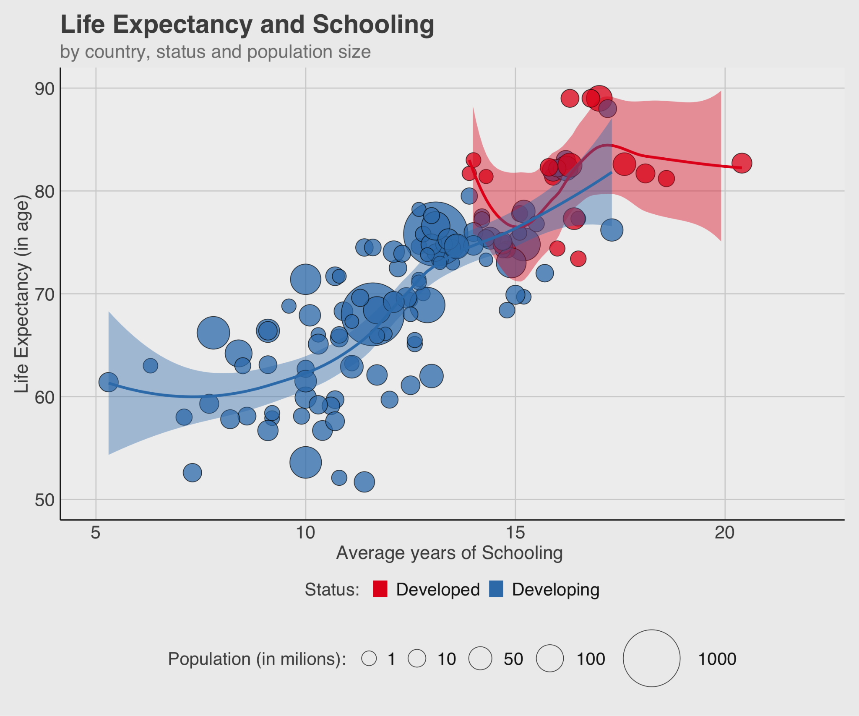

Question #1 | Results
Year of Schooling
Rise one year
Life expectancy
1.18 year ( 431 days)
Notes:
Echo

Slide 18

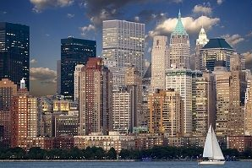


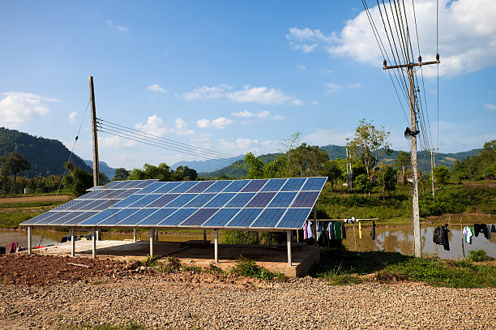

Question #2 | Introduction
Developed vs. Developing - What are the drivers?
Notes:
Dingkun

Slide 19
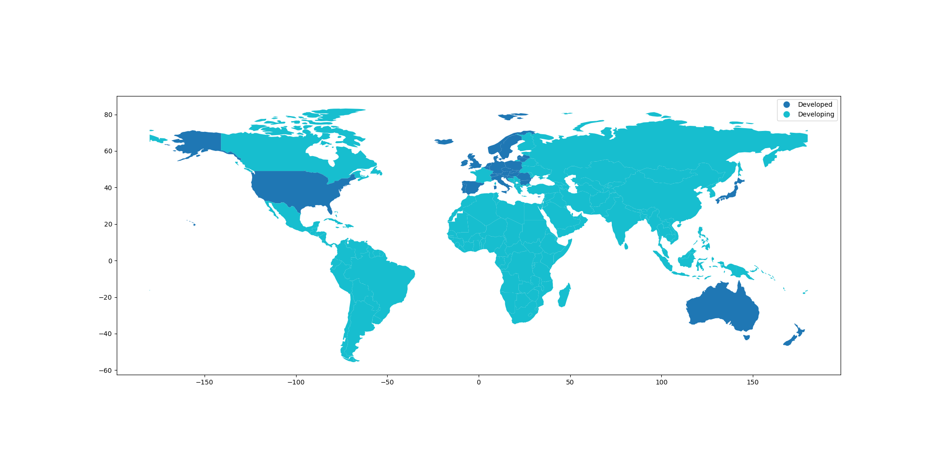
Question #2 | Introduction
"How did disease and mortality rates, along with national economic factors, contribute to a country's development status in 2014?"
Option: Can replace with a *good* graph of developed/developing data
Developed (Dark) vs. Developing (Light) Countries

Slide 20
Question #2 | Methods
Health
Life Expectancy
Body Mass Index (Average)
HIV/AIDS Fatalities
Social
Average Years of Schooling
Population (Est.)
Development Status
Economic
Income Composition of Resources
Gross Domestic Product (GDP)
Government Expenditure on Health (% GDP)
Logistic Regression
Used a priori
variable selection
to target specific
areas.

Slide 21


Question #2 | Results
Of all our predictors, only Income Composition of Resources yielded a significant p-value.
Variable | P-Value | Odds Change
Std. Income Composition of Resources | < 0.01 | 1.55
Log GDP per Capita | 0.14 | 0.68
Gov. Expenditure on Healthcare | 0.17 | 1.27
BMI | 0.23 | 0.97
Log Population | 0.26 | 0.71
Life Expectancy | 0.59 | 0.93
Years of Schooling | 0.59 | 1.31
HIV/Aids Deaths per 1000 | > 0.99 | -
Overall model results were positive, we found high degrees of accuracy (> 95%).
We have difficulty establishing exactly what Income Composition of Resources consists of.

Slide 22
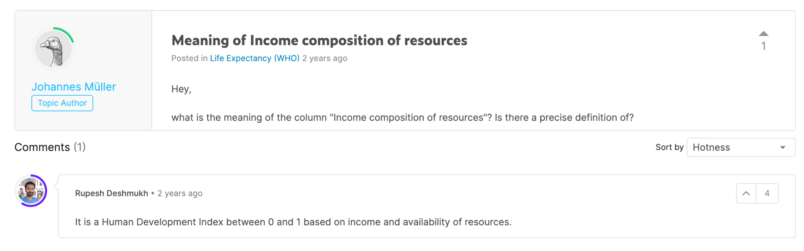
Question #2 | Results
We suspect Income Composition of Resources is a re-branded Human Development Index, which would make the results insipid.
https://www.kaggle.com/datasets/kumarajarshi/life-expectancy-who/discussion/192631

Slide 23
Question #2 | Final Results
After triaging the Income Composition variable, we determined it was troublesome
Dropped this variable and re-ran the model with the remaining predictors
It turns out education is a great indicator when identify whether the country is developing or developed
Variable | P-Value | Odds Change
Years of Schooling | 0.02 | 2.39
Life Expectancy | 0.06 | 1.21
Log Population | 0.13 | 0.68
BMI | 0.25 | 0.97
Gov. Expenditure on Healthcare | 0.27 | 1.17
Log GDP per Capita | 0.33 | 0.77
HIV/Aids Deaths per 1000 | > 0.99 | -
Notes:
Dingkun

Slide 24
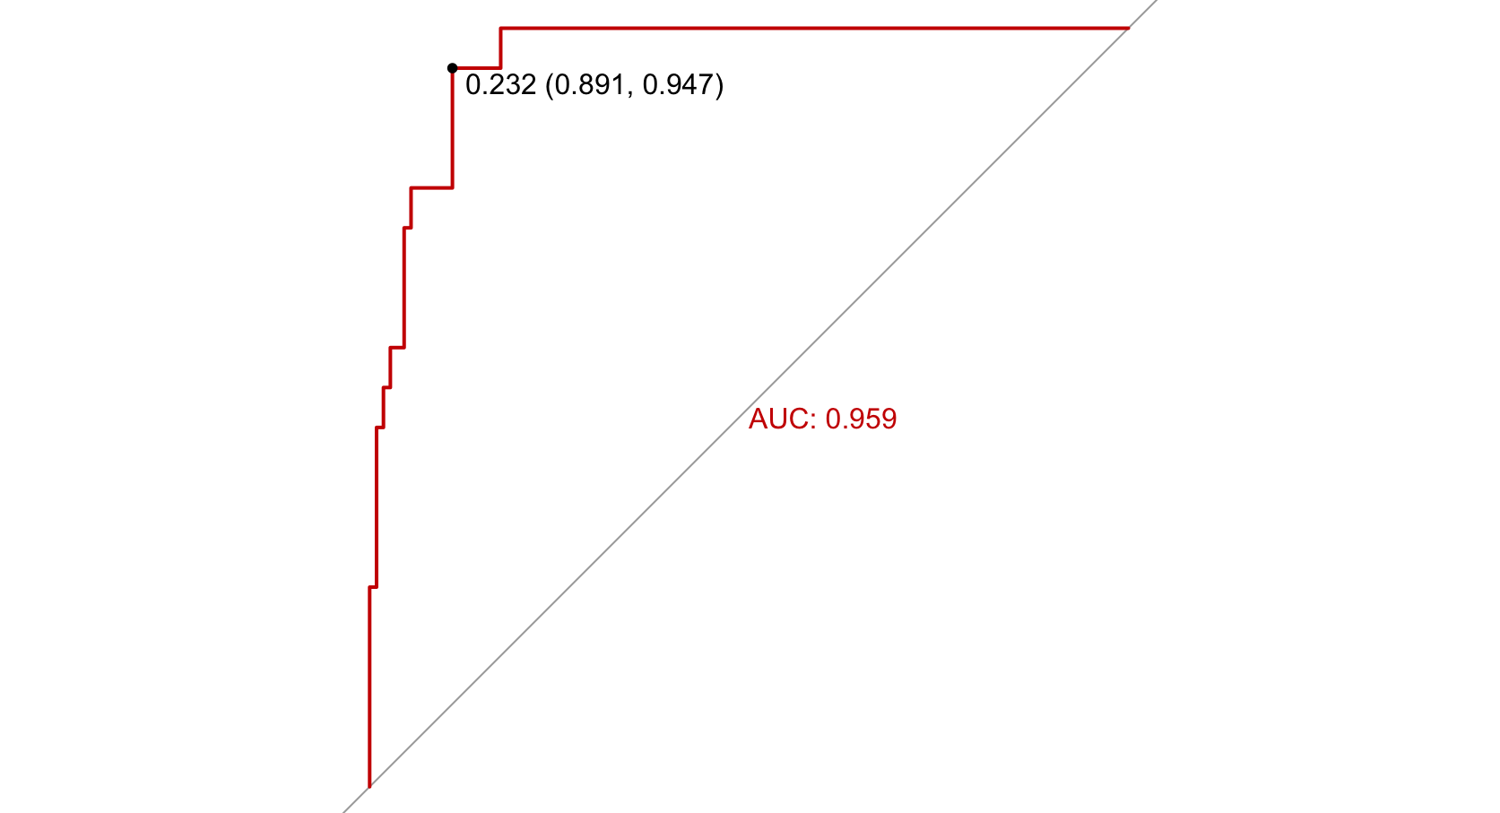
Question #2 | Assessment
Confusion Matrix
 | True Developed | True Developing
Pred. Developed | 11 | 5
Pred. Developing | 8 | 105
True Positive Rate
1 - True Negative Rate
95% C.I. of Accuracy: (0.83, 0.95)
Prediction Accuracy Curve for Final Fitted Model
with cut-off at 0.232 (“best” option)
Notes:
Dingkun

Slide 25
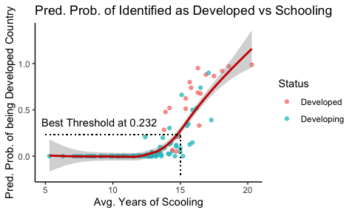
Question #2 | Assessment
Confusion Matrix
 | True Developed | True Developing
Pred. Developed | 16 | 9
Pred. Developing | 3 | 100
Out-of-Sample Test on Dataset of Year 2013
95% C.I. of Accuracy: (0.84, 0.95)

Slide 26
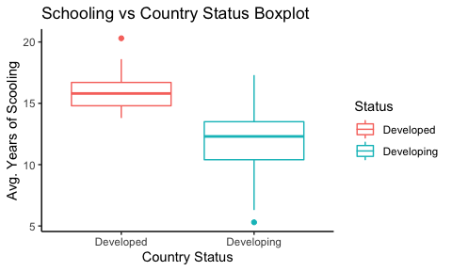
Question #2 | Assessment

Slide 27
Conclusion | What should we explore further?
Interaction between Development Status and HIV for Life Expectancy
Expected: better medical care and higher life expectancy in developed countries
Interaction between Development Status and Schooling for Life Expectancy
Expected: more schooling may not have an effect on life expectancy for developed countries
Explore the influence of the region/continent and find a way to include this in a future analysis
Changes in our categories over time. HDI is going up consistently, but still a lot of developing countries
Notes:
Pooja

Slide 28
Conclusion | Limitations
After triaging the Income Composition variable we determined it was troublesome.
There appears to be a “chain-of-custody” issue with data. Possibly changes as we go.
Substantial amounts of missingness, especially population.
Data Collected
Country of Origin
Dataset Constructed
Kaggle
Data Compiled
World Health Organization
Data Analyzed
Orange Team
Approximation of Data Pathway to Analysis
We established where the data would be sourced from the WHO, but could not verify replacement data in all cases. Appear to be changes en route.

Slide 29
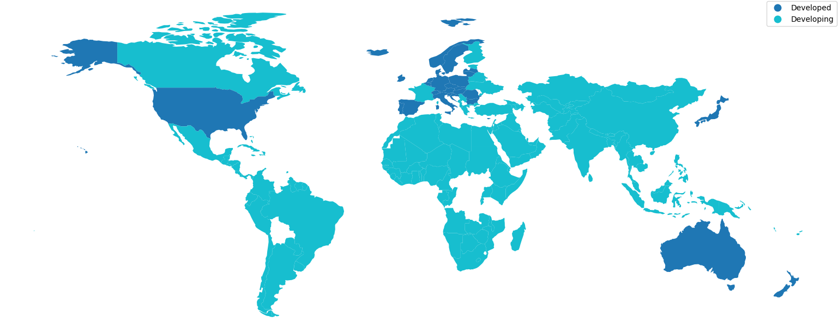
Conclusion | Limitations
Our dataset had
limitations that we
did not anticipate
prior to the project.
The biggest, and
hardest to resolve,
was the political
definition of a country,
and how that definition can change over time.
The map background and our dataset had different interpretations, some comical and some potentially confrontational.

Slide 30
Conclusion | Limitations
Our dataset had
limitations that we
did not anticipate
prior to the project.
The biggest, and
hardest to resolve,
was the political
definition of a country,
and how that definition can change over time.
The map background and our dataset had different interpretations, some comical and some potentially confrontational.

Slide 31
Conclusion | So What?
Most important lesson is about data integrity.
Even from reputable sources, data can still have issues that may not be apparent at the surface
We make the following recommendations:
For policy makers looking to improve average life expectancy, we confidently recommend prioritizing schooling, investing in healthcare, and taking population health measures as more deserving of attention
The significance of schooling on development status is noteworthy. We would make policy recommendations that encourage investment in this area.

Slide 32
Questions?

